Slide 1
OEP 2024

Slide 2
Industry Trends
The cost of job-based health care coverage for 2024 is expected to rise at its fastest pace in years as inflation pervades insurance policies.
Nearly one-quarter of employers are planning to or considering offering a narrow network of providers in the next two years, according to a WTW survey of 457 employers who have a total of 7.3 million workers.
There has been a significant uptick in the use of specialty drugs, particularly those for diabetes and weight loss. The average monthly cost per member for this class of drugs roughly doubled between 2022 and this year, adding around 1 percentage point to next year’s hike.
According to analysts, group health insurance premiums are excepted to see the largest rate increases for 2024 since 2018. More than likely double the rate increases from 2023.
According to Newsweek, health care insurance costs are anticipated to hit a 10-year-high in 2024.
Conclusion, for most American employees, they will spend more money in premiums and have access to limited care.

Slide 3
2024 Life U Beat All Trends
No premium increase for 2024

Slide 4
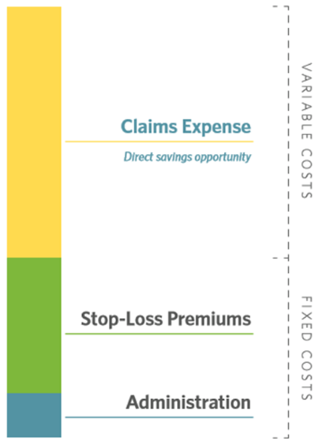
Cost Containment
The goal of cost containment solutions is to keep premiums from rising at astronomical rates
It takes everyone to come together to enact change, and out perform the “Trends”
Roughly 70% of an insurance plan build is variable costs/claims
Though Exemplar does a lot of these cost containment solutions behind the scenes, it is important to be a great consumer of healthcare (example – ER visits).
It is very important that if you receive a call from our cost containment team and partners, we work together timely to limit your exposure to unneeded high costs claims and Rx’s

Slide 5
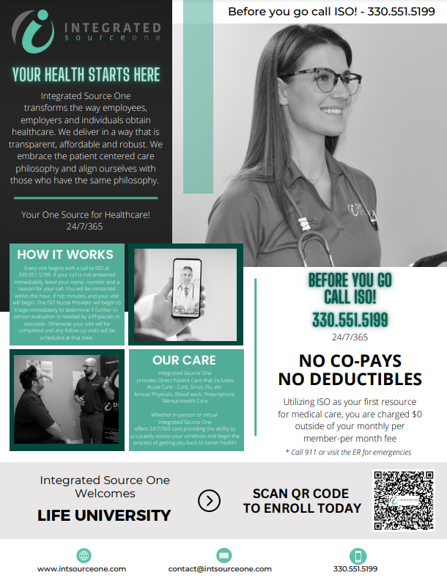
Cost Containment Opportunities

Slide 6
“Change is a process NOT an event!”
Cost Opportunities Comparison
Integrated Source One
Rx
Cancer
Diabetes
Hospital Bill Eraser
Durable Medical Equipment
Medical Management
Utilization Management
Labs
Imaging

Slide 7
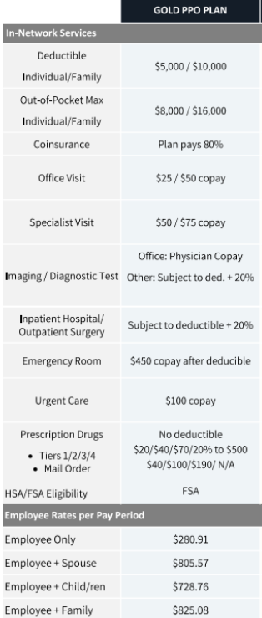
Medical Plan Comparison

Slide 8
Member Services & Claims Processing

Slide 9
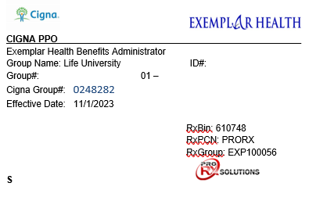
Your Member ID Card
(Front)
Provider Network
Member ID #
Member Sequence #
Member Name
Member Group #
Cigna Group #
Pharmacy Benefit Info

Slide 10
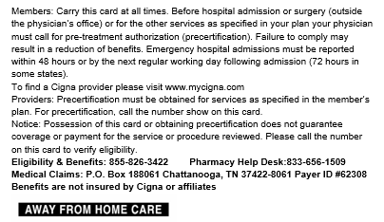
Your Member ID Card
(Back)
Prior Authorization for
procedures (provider use)
Website to locate a provider
Member Services Contact #
Pharmacy Customer Service
Provider Claims Submission Info

Slide 11
Gateway Portal Registration
The Gateway Member Portal allows members to view Explanation of Benefits and send messages to member services. Please follow this process to register for portal access. Members will need to log in to this portal to obtain Explanation of Benefits documents for claims that have been processed. EOB’s will not be mailed to Members.
Go to Exemplar Health Benefits Administrator (exemplarhba.com)
Click the Groups button
Click Members
Click Gateway Portal
Click Member Login
Click on the “Click here to register” button
Select “Member” in the portal drop down
Complete all other required fields.
Check your email to validate your registration.
Now you are ready to log in to access your information.
If you have any questions or concerns, please contact Member Services at (855) 826-3422.

Slide 12
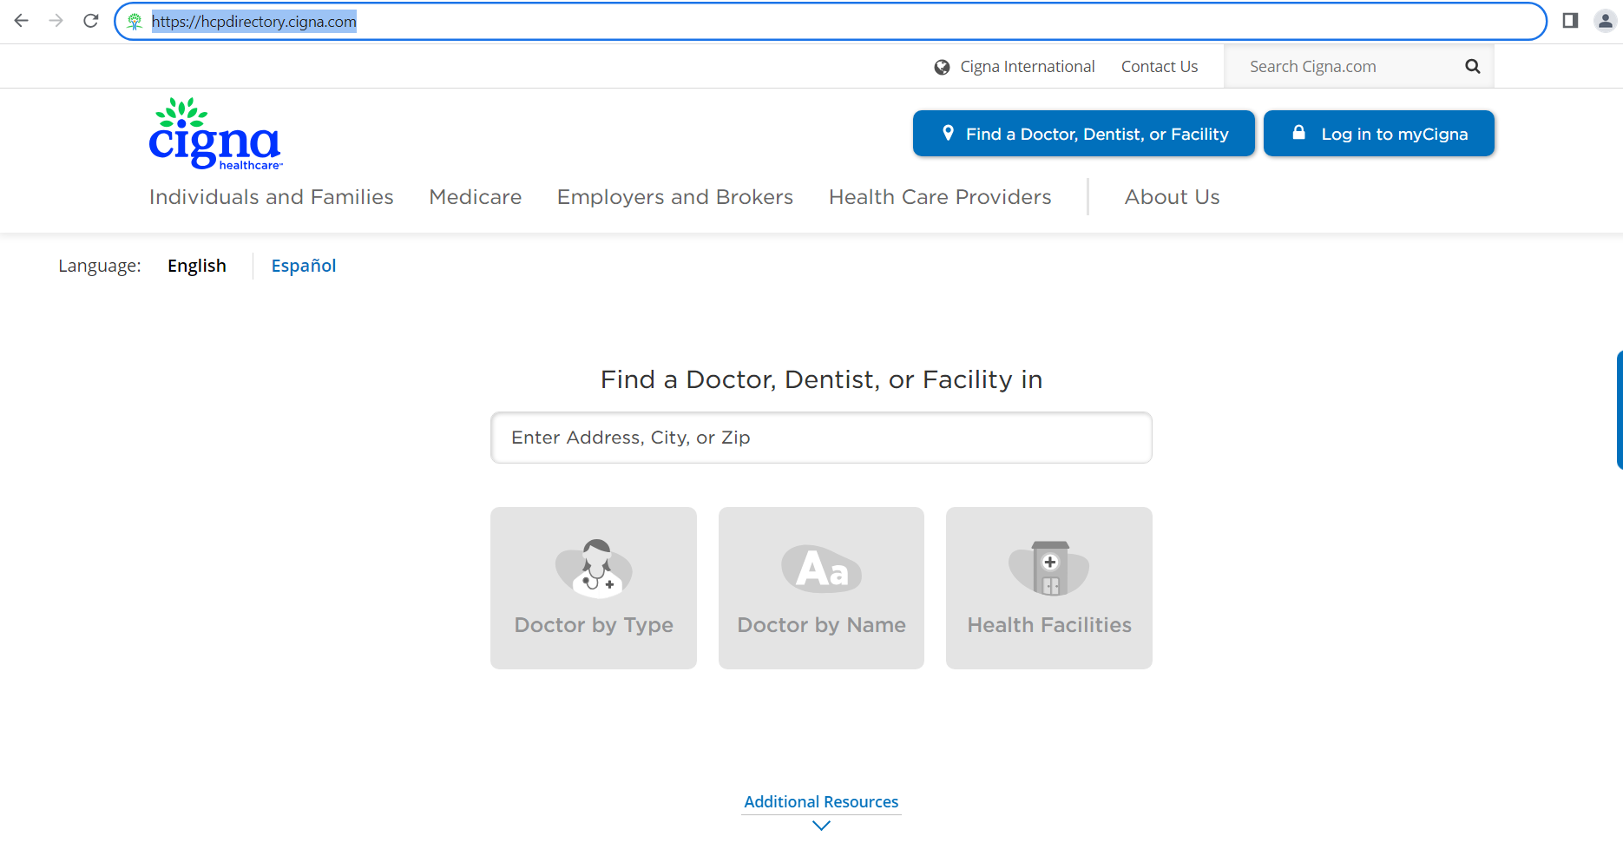
Visiting Your Provider
Please verify that your provider is in network prior to your visit if possible by visiting the website for Cigna (https://hcpdirectory.cigna.com) which is the network access for your plan. If you are unable to locate your provider or would like help, please contact Member Services at (855) 826-3422.
Please note that you do not have to create a log in to search for a provider.

Slide 13
Visiting Your Provider
Present your most recent Member ID card upon arrival
Be sure to let the receptionist know that you have access to the Cigna network of providers. This is important.
Claims will be billed by the provider to the payer ID or address on the back of your card.
Claims will be priced by the network.
Claims are then forwarded to EHBA for adjudication and processing.
Once processed, you will be able to view the EOB within your Gateway portal.
Please contact Member Services regarding any claims or provider issues.

Slide 14
Claim Submission
If you do not see an EOB in the system within 30 days of your appointment, your provider’s claim has not been received by EHBA. Please contact your provider and request the claim to be submitted.
Member Services can also assist in obtaining the claim from the provider if necessary.

Slide 15
Member Services = Your Best Resource
Please contact Member Services by email, portal message or phone should you have any issues or concerns throughout the plan year. The team is more than happy to assist you in any way possible.

