Slide 1
Employee Benefits Presentation 2024

Slide 2
Making Changes to your Benefits
Open Enrollment is your one time per year to make changes to any of your benefits without a qualifying life event.
The elections you make will remain in effect for the plan year unless you experience an event such as:
Marriage, divorce, legal separation
Birth, adoption, qualified Medical Child Support Order
Death of a dependent
Change in your work status or your spouse’s work status that affects your benefits
Your spouse’s annual open enrollment (loss/gain of other coverage)
Changes due to a qualified event must be submitted to Human Resources and entered in the benefits portal within 30 days of the date of the event.

Slide 3
Dental
Digital ID cards only
 |  | DHMO |  |  |  | MAC PPO |  |  |  | 90th PPO
Annual Deductible |  | N/A |  |  |  | $50 / $150 |  |  |  | $50 / $150
Annual Plan Maximum |  | N/A |  |  |  | $1,500 |  |  |  | $1,500
Annual Rollover Amount |  | Not Included |  |  |  | Wellness Plus Incentive |  |  |  | Wellness Plus Incentive
Preventive Services |  | 100% |  |  |  | 100% (deductible waived) |  |  |  | 100% (deductible waived)
Basic Services |  | Fee Schedule |  |  |  | 100% |  |  |  | 80%
Major Services |  | Fee Schedule |  |  |  | 60% |  |  |  | 50%
Periodontics (root planing) |  | Fee Schedule |  |  |  | 100% |  |  |  | 80%
Endodontics (root canal) |  | Fee Schedule |  |  |  | 60% |  |  |  | 50%
Orthodontia (children to age 19) |  | Fee Schedule |  |  |  | 50% to $1,500 Lifetime Max |  |  |  | 50% to $1,500 Lifetime Max
Waiting Periods |  | None |  |  |  | None except for Late Entrants |  |  |  | None except for Late Entrants
UCR Payment Level |  | N/A |  |  |  | MAC |  |  |  | 90th
DID YOU KNOW? If you plan on having dental work in excess of $300, ask your dentist for a “predetermination of benefits” so you know how much you will have to pay before services are performed.

Slide 4
Vision
 |  | Vision PPO
Exam |  | $10 Copay
Frequency |  | Once every 12 months
Lenses Single/Bifocal/Trifocal |  | $25 Copay
Frequency |  | Once every 12 months
Frames |  | $130 Allowance
Frequency |  | Once every 12 months
Contact Lenses Conventional |  | $130 Allowance
Contact Lenses Medical |  | Covered in full
Frequency |  | Once every 12 months
Frame benefit varies by retailer.
Visit Cigna.com and select the Cigna Vision PPO Network to locate an in-network vision care provider.

Slide 5
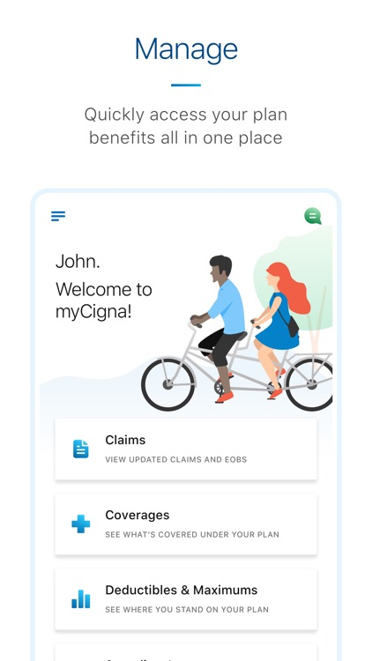
myCigna.com
Some things you can do within myCigna.com or the mobile app:
View ID Card
Access and view health claims
Review plan deductibles and coinsurance
Look up cost of procedures and prescriptions
Find doctors nearby
5

Slide 6
Flexible Spending Account (FSA)
Health Care Flexible Spending Account (FSA): $3,200
Qualified Health Care Expenses
Rollover of $640 into next plan year
Limited Purpose Flexible Spending Account (LP-FSA): $3,200
Must be enrolled in one of the medical HDHPs
Funds can be used only for qualified dental and vision expenses
Rollover of $640 into the next plan year
Dependent Care Flexible Spending Account (DC-FSA): $5,000 household max
Qualified Dependent Care or Elder Care expenses to allow you (or your spouse) to work or go to school
Debit MasterCard available for the Health Care Account.
You must submit receipts for non-copay expenses.
Must re-elect every year.

Slide 7
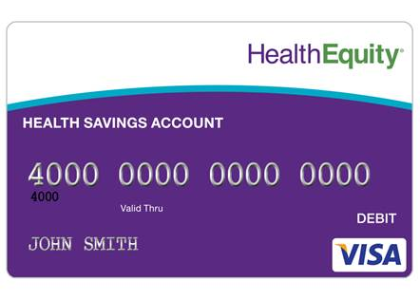
HSA Bank Account
If you enroll in a HDHP plan, you may elect to enroll in an HSA bank account.
2024 IRS HSA Contribution Limits
Employee Only: $4,150
Family: $8,300
Age 55+ years – contribute an additional $1,000 per year
Life University contributes to your HSA. The amount is dependent upon
your medical coverage tier.
To open and contribute to an HSA you must:
Be covered by a qualified high deductible health plan
Not be enrolled in Medicare or Tricare
Not have any other health coverage that pays for out‐of‐pocket healthcare expenses before you meet your plan deductible, including Medicare A and B
Not have received any VA health benefits within the last 3 months
Not be enrolled in a Medical FSA Account
You can enroll in a Dependent Care FSA + Limited Flexible Spending Account

Slide 8
Benefits of your HSA
Portability: You own the personal bank account and can take the funds with you if your job changes, you retire or become unemployed.
Tax savings: Your HSA provides triple tax savings:
Contributions to your account are pre-tax
Investment Earnings are tax free
Withdrawals for qualified medical expenses are tax free
Unused HSA funds roll over year after year: There is no limit on the total amount you can have in your HSA.
Flexibility: You decide how to use the money – save it or spend it on healthcare expenses.
Qualified medical expenses prior to age 65
After age 65, you can withdraw the funds without penalty; similar to a 401(k)
5. Balance can grow: Through investment earnings
You can pursue many different investment options once your account balance meets a certain threshold. Health Equity’s threshold is $2,000.
Help pay for family members’ medical expenses as long as they are a tax dependent listed on your IRS filing
8

Slide 9
Eligible HSA Expenses
Acupuncture
Ambulance
Chiropractor
Dental treatment
Prescription drugs
Long-Term Care
Hospital Services
Durable Medical Equipment
Flu Shot
Diabetic Test Kit/Strips
Drug Addiction Treatment/Counseling
Diagnostic Services
Hearing Aids
Nursing services
Speech therapy
Smoking cessation program
Surgery (non-cosmetic)
Vision services
Wheelchair
Therapy
This list is not exhaustive. Please refer to HealthEquity.com/QME for a complete list.
9

Slide 10
Basic Life/ AD&D
Life University pays 100% of the cost of Basic Life and Accidental Death and Dismemberment for employees.
$50,000 benefit
Matching Accidental Death & Dismemberment benefit
IMPORTANT REMINDER
Please remember to keep your beneficiary up-to-date throughout the year. Open Enrollment is a great opportunity to check and update this information on an annual basis.

Slide 11
Voluntary Life/ AD&D
You must elect personal Voluntary Life/ AD&D coverage in order to elect spouse and/or child coverage.
Insured | Coverage Amounts
Employee | · Increments of $10,000 · Maximum benefit of $500,000 or 5x annual salary, whichever is less · Guaranteed Issue $200,000
Spouse | · Increments of $5,000 · Maximum benefit of $150,000, not to exceed 50% of employee amount · Guaranteed Issue $50,000
Children | · Increments of $1,000 · Maximum benefit of $10,000 · Guaranteed Issue $10,000
Medical questions are required:
at initial eligibility for amounts elected over the Guaranteed Issue (GI) amounts listed above.
at open enrollment if you are increasing your benefit amount by more than 2 increments or above the GI.
If you waive this benefit when it is first offered to you and decide to enroll later, you will be required to answer medical questions for any amount of coverage.
You must complete an Evidence of Insurability (EOI) form and return to the carrier for final approval.

Slide 12
Disability : Income Protection
Disability coverage can be one of the most important benefits you have. It provides you and your family with financial protection if you are ever unable to work due to an illness or non-work related injury. Benefits will be paid as long as the employee remains eligible for benefits.
Short-Term Disability (STD)
Long-Term Disability (LTD)
Benefit Percentage | 100%
Benefit Duration | 13 Weeks
Elimination Period | 14 days
Benefit Percentage | 60%
Monthly Maximum | $5,000
Benefit Duration | SS Retirement Age
Elimination Period | 90 Days
*IMPORTANT*
The STD plan includes a 12-month waiting period for new hires.
The LTD plan does not cover any disabilities caused by, contributed to, or resulting from a pre-existing condition. A condition is considered pre-existing if you received medical treatment, consultation, care, services, or took prescribed drugs in the three months just prior to your effective date of coverage. After you have been covered under the plan for twelve months, pre-existing condition limitations no longer apply.

Slide 13
Employee Assistance Program (EAP)
100% Confidential Services - Available 24/7
With the Cigna EAP program, you can get support for everyday issues as well as life’s tough challenges.
Assistance is available for:
Emotional Health – receive 1-8 sessions per issue per year
Home Life Referrals – referrals to community resources and services
Financial and Legal Assistance – free consultation (time limits do apply)
Monthly Wellness Seminars
www.myCigna.com
Call 1-877-622-4327
Employer ID: lifeu

Slide 14
Accident
Accident Insurance is designed to help you fill some of the gaps caused by increasing deductibles, copayments and out-of-pocket costs related to an accidental injury.
Coverage for:
Sports-related accidental injury, including children’s sports
Broken bone or dislocation
Burn or laceration
Concussion or coma
Back and knee injuries
ER-visit, follow-up physician visit as a result of an accident
This plan pays out based upon a fee schedule. Refer to the benefits summary for more information.
Also included is a $50 Wellness Benefit. If you are enrolled in one of the other Cigna plans that pays a wellness benefit, you are eligible for the benefit under both plans!

Slide 15
Critical Illness
Critical Illness insurance provides the ability for an insured to receive a lump sum benefit payment upon first and second diagnosis of any qualified Critical Illness. Benefits are paid directly to you when you need it most.
Coverage for 19 conditions including:
Heart Attack
Stroke
End Stage Renal Failure
Major Organ Failure
Cancer
Advanced Alzheimer’s
ALS
Parkinson’s
Multiple Sclerosis
Cerebral Palsy
Employees may purchase a flat benefit amount of $10,000, $15,000 or $20,000.
Spouses are eligible for up to 50% of the employee amount. Child(ren) can be covered at 25% of the employee amount.
Guaranteed Issue Amounts: $20,000 for employees, $10,000 for spouses, and any amount for child(ren). This is the amount of coverage for which members are eligible at initial eligibility (new hire) without answering medical questions.
The plan also includes a $50 Wellness Benefit. Remember – you can double dip on this benefit!
A medical questionnaire known as Evidence of Insurability (EOI) is required if you waive this benefit when it is first offered to you and decide to enroll later. This form is also required if you are electing to increase your benefit amount.

Slide 16
Hospital Care
Cigna’s Hospital Care plan provides you with additional financial protection for out-of-pocket expenses associated with a hospital stay.
The plan pays a Hospital Admission benefit of $1,000. Maximum of one benefit per calendar year per covered person.
Then, there’s a $100 per day Hospital Stay benefit. Limited to 30 days.
Additional benefits for ICU admission and stay.
Also included is a $50 Wellness Benefit. This benefit is payable once per calendar year per covered person just for completing your annual health screening. That’s right – Cigna wants to pay you for having your free preventive care screening or COVID-19 immunization completed!

Slide 17
Universal Life and Long-Term Care
Employee |  | Up to $75,000
Spouse |  | Up to $15,000
Includes a Long-Term Care Rider that will pay up to $3,000 a month for 50 months for a total of $150,000 in benefits.
Tobacco and Non-Tobacco Rates
30 day waiting period after the effective date for sickness
No physical or blood work required
To enroll, please download the paper application from the ADP system and submit to Human Resources.

Slide 18
Long Term Care
Long Term Care provides coverage for you if you couldn't independently perform the basic activities of daily living: bathing, dressing, using the toilet, transferring from one location to another, continence and eating, or if you suffered severe cognitive impairment from a condition such as Alzheimer's disease.
Elect up to $8,000 and a Facility Benefit Duration of 3 or 6 years.
Evidence of Insurability (EOI) form required for Employees if you did not apply during initial eligibility or are increasing your benefit amount. Spouses and all family members must compete the Benefit Election Form and the EOI form for approval.
Please review and enroll through the website at: http://unuminfo.com/LifeUniversity/index.aspx for additional information or you may contact UNUM at 800-227-4165.
Won't my other insurance pay for long term care?
Unfortunately, no. Medical insurance and Medicare are designed to pay for specific care for acute conditions — not for long term help with daily living. Medicaid only helps with long term care expenses after you have depleted virtually all of your assets.
Life University pays $25 per month towards the cost of Employee Only coverage.

Slide 19
Legal Services
Plan Options
Legal Plan “Stand Alone”
Legal Plan “with Identity Theft Shield”
Identity Theft Shield Only
Life Events Legal Plan
Phone consultation, letter writing, contract and document review
Will, Living Will and related documents
Motor Vehicle Legal Defense Services
Trial Defense Legal Services
IRS Audit Services
25% Member Discount off legal services not covered under plan
Identity Theft Shield
Current credit report with detailed analysis and score
Continuous credit monitoring
Identity Restoration Services by Kroll licensed investigators
Please enroll on the ADP website. For additional information visit www.legalshield.com/info/lifeedu or call Nanette Freiman 770-393-8290 or nsfreiman@bellsouth.net

Slide 20
Questions / Contacts
 | Phone | Web/email
Cigna – Dental, Vision | 800-244-6224 | mycigna.com
Cigna - Life, Disability | 800-997-1654 | cigna.com
McGriff – FSA | 800-768-4873 | mcgriff.com/flex
Health Equity – HSA | 866-346-5800 | healthequity.com
Cigna Worksite | 800-754-3207 | supphealthclaims@cigna.com
Transamerica | 888-763-7474 | transamerica.com
Unum | 800-227-4165 | unuminfo.com/lifeuniversity/index.aspx
Employee Assistance Program | 877-622-4327 | mycigna.com

